Slide 1
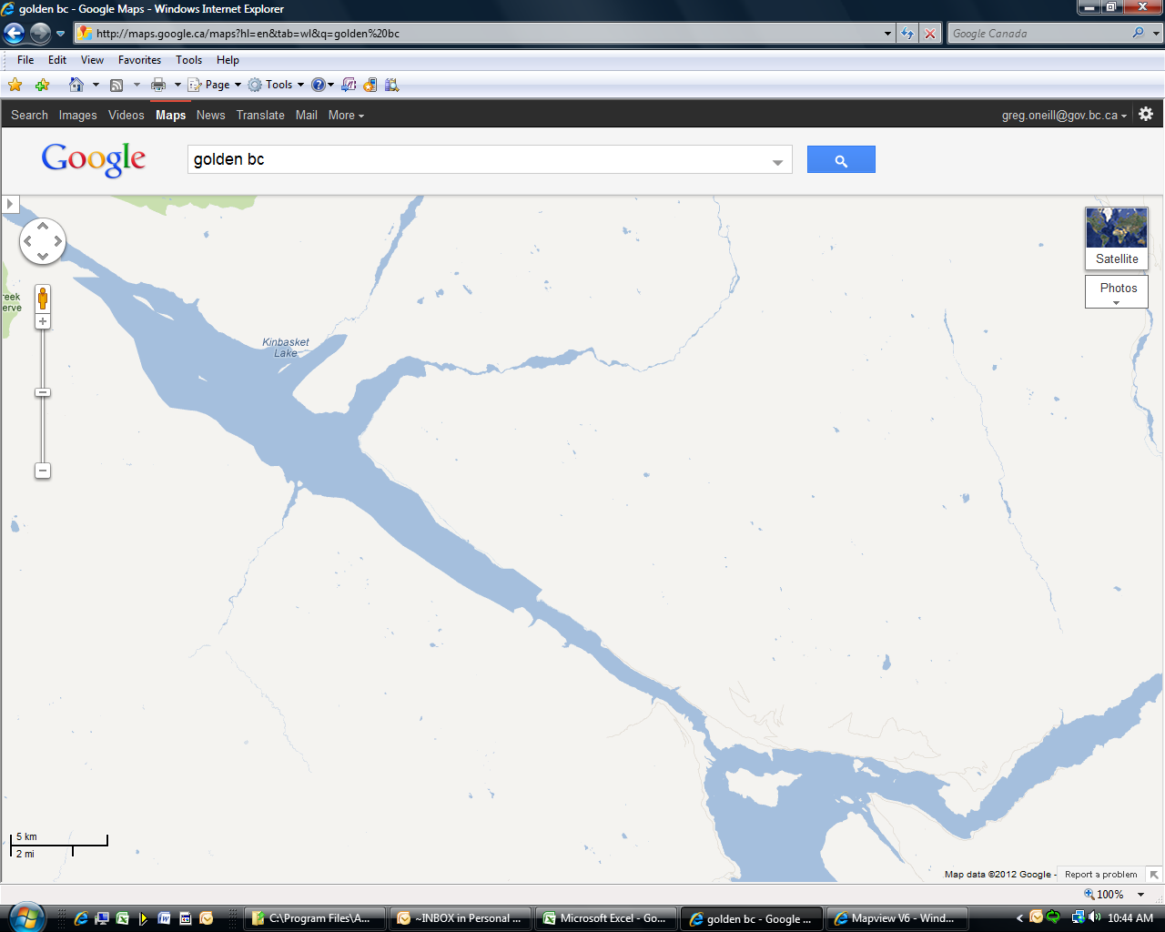
Golden - AMAT

Slide 2
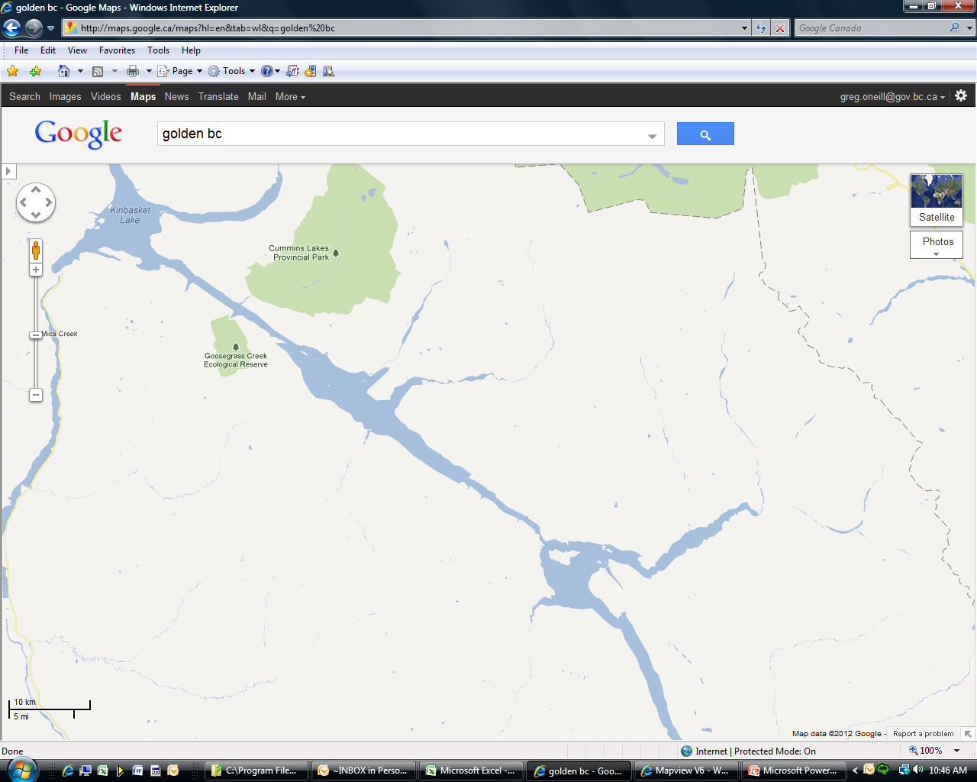
Golden - AMAT

Slide 3
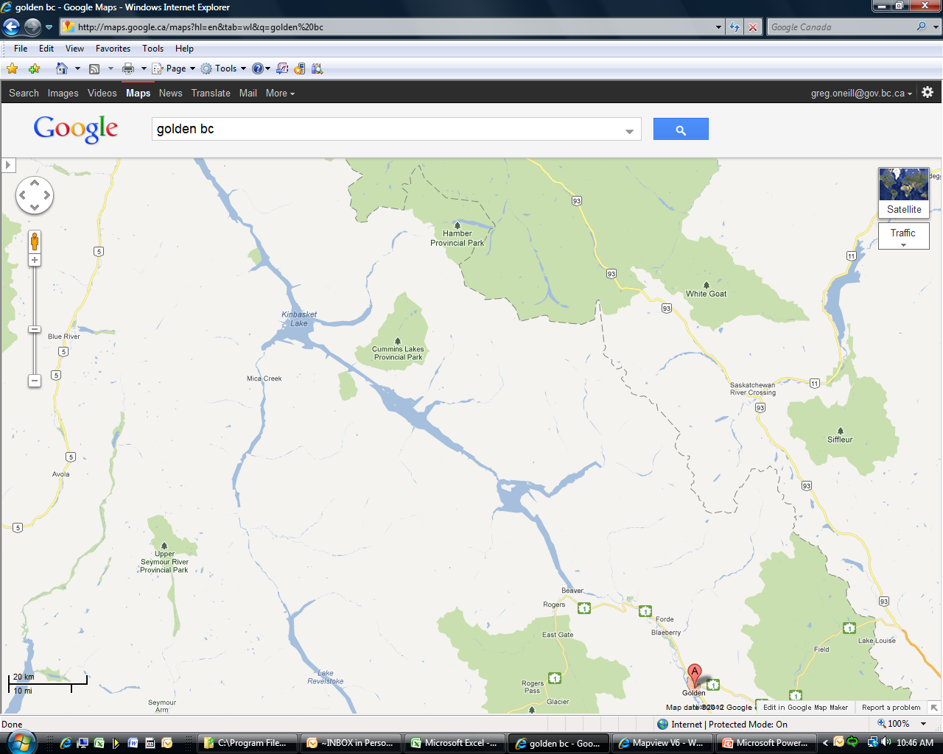
Golden - AMAT

